Slide 1
Principles of Data Science
Li Niu

Slide 2


Data
Information

Slide 3

Is there a man?
Where is he?
What is he doing?
How many balls?
Which ball is closer?
….
Data
Information

Slide 4


Is there a man?
Where is he?
What is he doing?
How many balls?
Which ball is closer?
….
Structured Data
Non-structured Data
Information

Slide 5
Structured Data
Information
Is there a man?
Where is he?
What is he doing?
How many balls?
Which ball is closer?
….
Model

Slide 6
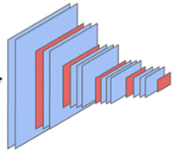
Structured Data
Information
Deep Learning
Is there a man?
Where is he?
What is he doing?
How many balls?
Which ball is closer?
….

Slide 7
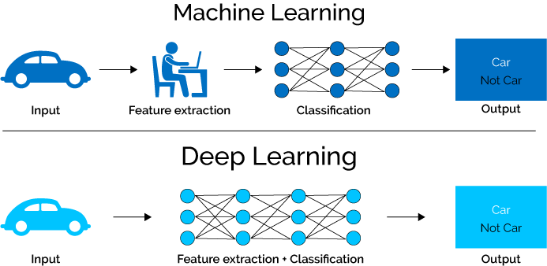
Deep learning model is end-to-end system

Slide 8
Deep learning model is end-to-end system

Slide 9
Prior to deep learning, we first extract features
extract deep learning features

Slide 10

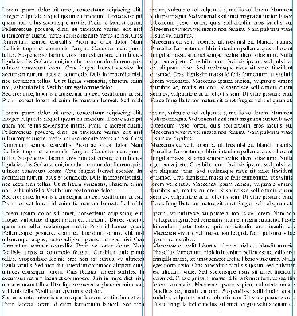
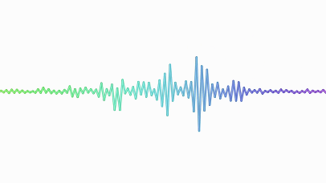
Different modalities have different types of features
SIFT
SURF
GIST
….
image
TF-IDT
LSA
Topic model
….
text
sound
MFCC
….

Slide 11
Q: What is feature?

Slide 12
Q: What is feature?
A: Key information

Slide 13


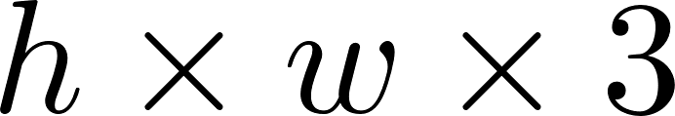


The naive feature is redundant and noisy
….
For a RGB image, the length of vector is 1,228,800

Slide 14

Extract key information as feature
feature
extractor

Slide 15
Feature should be robust with scale, rotation, etc

Slide 16

Training stage:
This is a cat.
Testing stage:
Q: Is this a cat?
A: I am not sure.
Q: Is this a cat?
A: I do not know.

Slide 17
How to extract robust features?

Slide 18
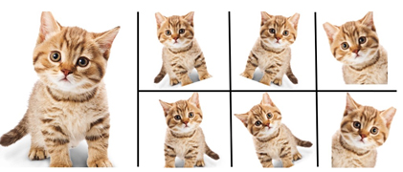
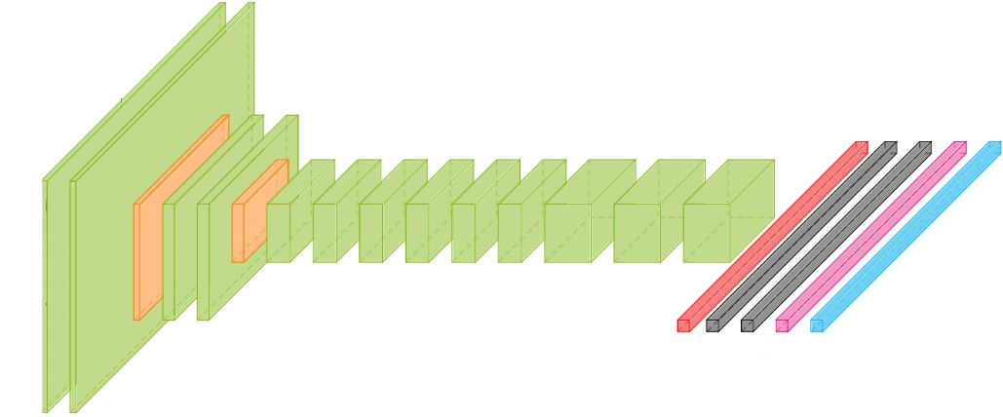
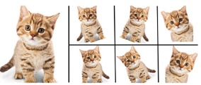
Data augmentation
Enlarged training set
cat
dog
…
bear

Slide 19
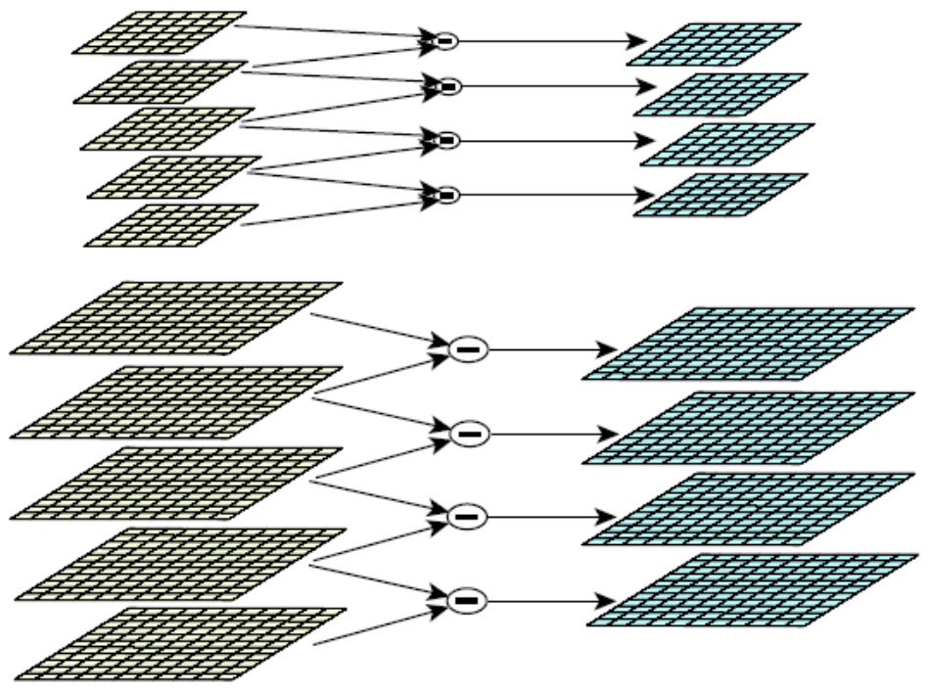
Scale-invariance
Scale-Invariant Feature Transform (SIFT)
next octave
first octave
Gaussian pyramid
Difference of Gaussian (DoG)

Slide 20
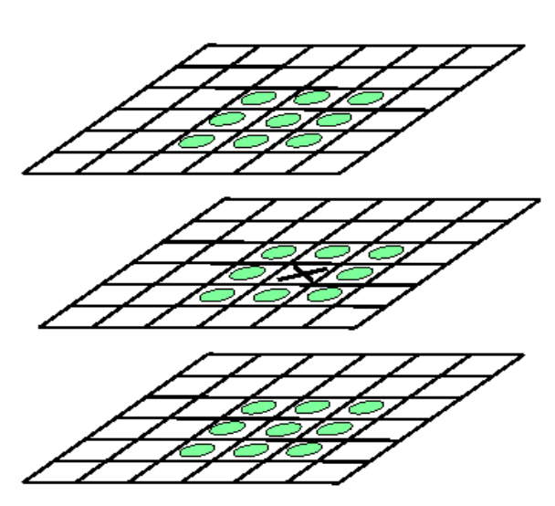
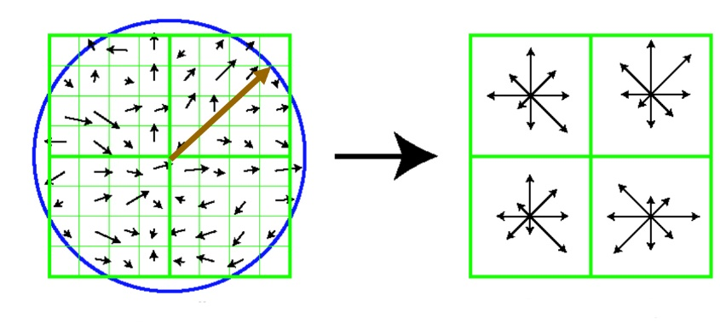
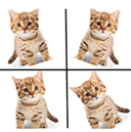
Rotation-invariance
Scale-Invariant Feature Transform (SIFT)
Locate the keypoints
Extract keypoints descriptors
based on gradient histogram
dominant direction

Slide 21
Do some post-processing on features….

Slide 22
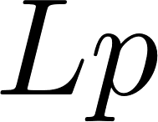
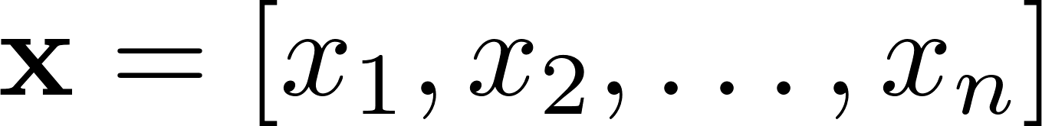

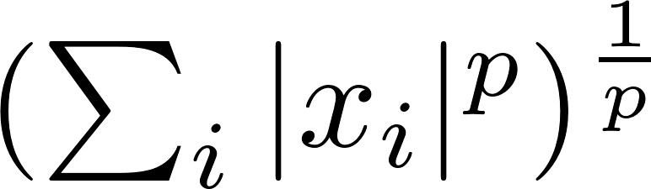
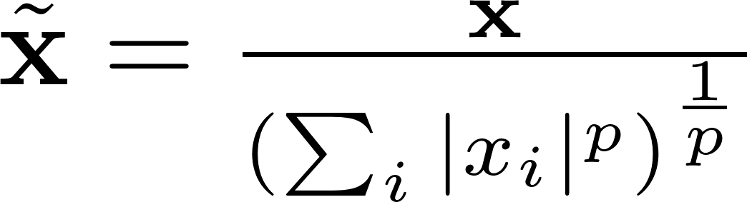

normalization
Feature norm is the distance between and
norm:
normalization:
After normalization, norm of is 1

Slide 23
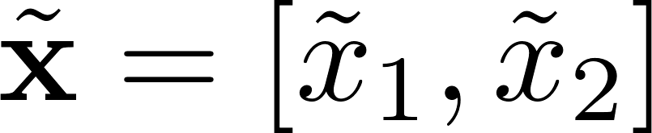
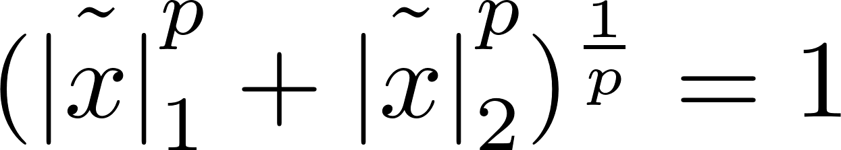
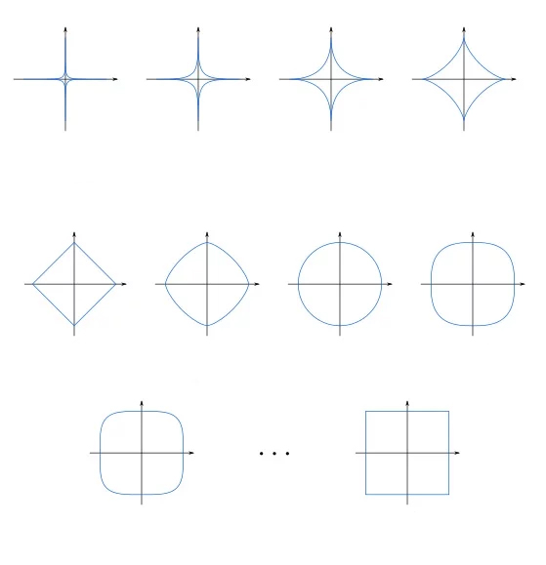
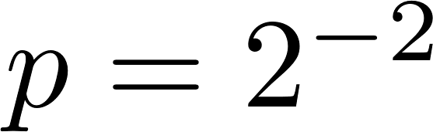
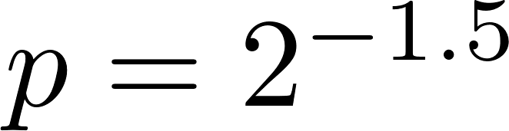
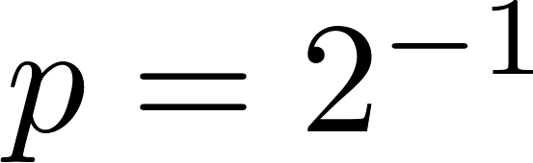
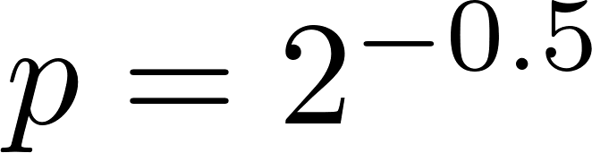
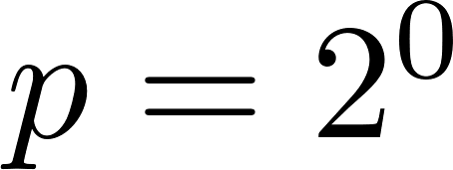
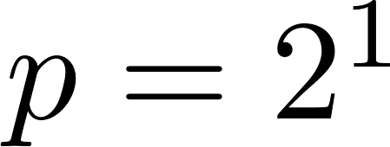
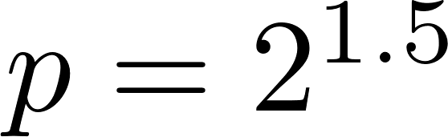
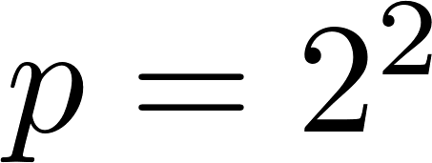
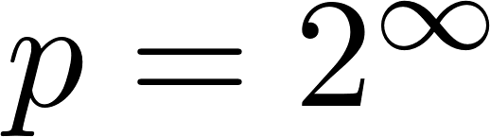
normalization
2-dim feature

Slide 24
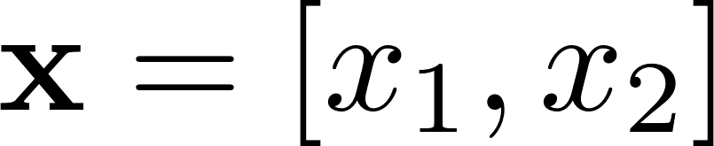
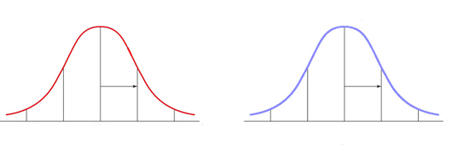


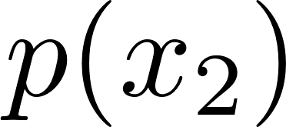
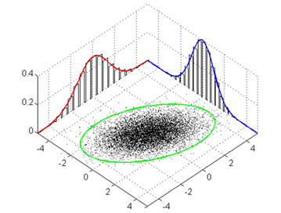
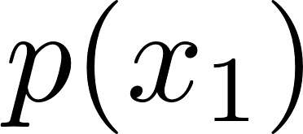


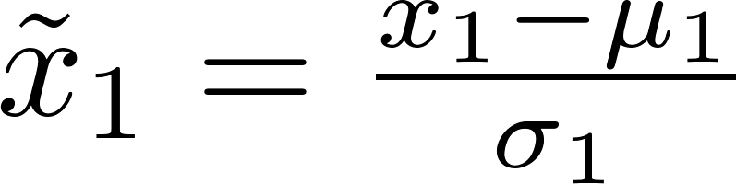
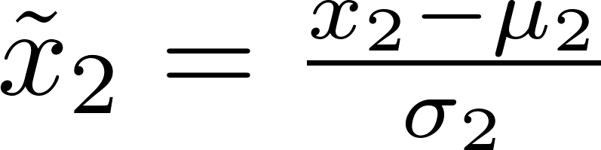
Z-score normalization
2-dim feature
-4 -2 0 2 4
-2 -1 0 1 2

Slide 25
Example of Z-score normalization
Data from Facebook
friends = [109, 1017, 1127, 418, 625, 957, 89, 950, 946, 797, 981, 125, 455, 731, 1640, 485, 1309, 472, 1132, 1773, 906, 531, 742, 621]
happiness = [0.8, 0.6, 0.3, 0.6, 0.6, 0.4, 0.8, 0.5, 0.4, 0.3, 0.3, 0.6, 0.2, 0.8, 1, 0.6, 0.2, 0.7, 0.5, 0.3, 0.1, 0, 0.3, 1]
 | friends | happiness
0 | 109 | 0.8
1 | 1017 | 0.6
2 | 1127 | 0.3
3 | 418 | 0.6
4 | 625 | 0.6
… | … | …
 | friends | happiness
0 | -1.57 | 1.13
1 | 0.52 | 0.39
2 | 0.78 | -0.73
3 | -0.85 | 0.39
4 | -0.38 | 0.39
… | … | …
Z-score normalization

Slide 26
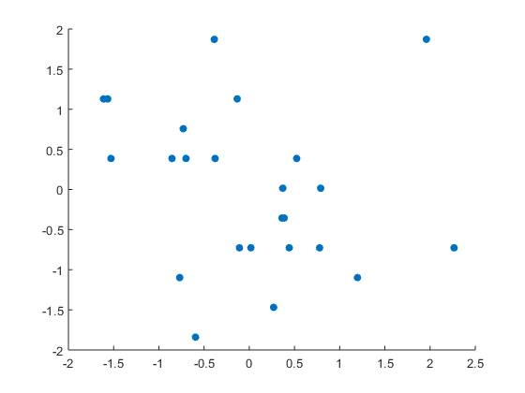
Example of Z-score normalization
Data from Facebook
friends = [109, 1017, 1127, 418, 625, 957, 89, 950, 946, 797, 981, 125, 455, 731, 1640, 485, 1309, 472, 1132, 1773, 906, 531, 742, 621]
happiness = [0.8, 0.6, 0.3, 0.6, 0.6, 0.4, 0.8, 0.5, 0.4, 0.3, 0.3, 0.6, 0.2, 0.8, 1, 0.6, 0.2, 0.7, 0.5, 0.3, 0.1, 0, 0.3, 1]
happiness
friends

Slide 27

Spatial pyramid
Losing spatial information
pooling
SIFT feature
encoded SIFT feature
pooling
Deep learning feature

Slide 28
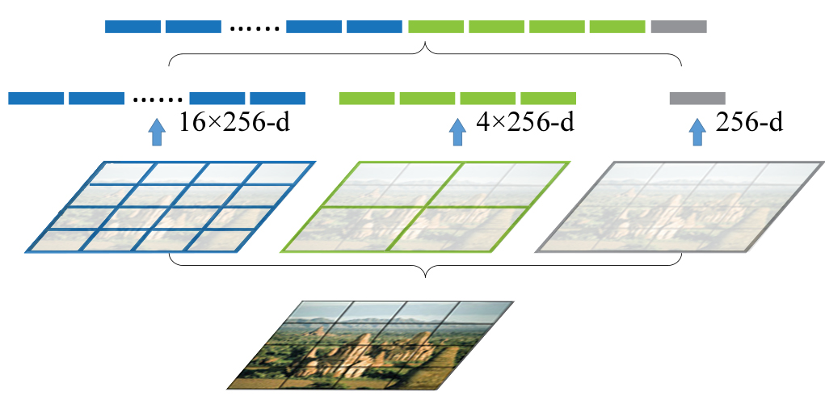
Spatial pyramid
concatenate features
uniformly divide the image

Slide 29
Thanks!

